Slide 1

SREENIDHI INSTITUTE OF SCIENCE AND TECHNOLOGY
(An Autonomous Institution)
DEPARTMENT OF CSE- AI & ML
A Design seminar on Retail Theft Detection using Deep Learning BY
Cherupally Abhinay (21311A6624)
Boggula Naga Krishna Reddy (21311A6608)
Kachu Revanth (21311A6628)
Under the Guidance of
Mr.G Ravi , Mrs. K . Divya Sri, Dr K. Shirisha , Assistant Professor, Assistant Professor , Professor,
Group Project Coordinator, Department of CSE-AI & ML , Dept of CSE-AI &ML Department, CSE-AI & ML ,SNIST SNIST SNIST

Slide 2
Abstract
Shoplifting is a significant concern for retailers, leading to substantial financial losses annually. Traditional security measures, such as CCTV surveillance and human monitoring, often fail to provide real-time intervention due to their dependence on manual oversight. This project proposes an automated shoplifting detection system leveraging YOLOv8 (You Only Look Once) for real-time object detection, DeepSORT for identity tracking, and OpenCV for video processing. The system is designed to detect suspicious behaviors such as loitering (staying in a particular area for an extended period) and concealment (placing an item close to the body or within clothing). By integrating advanced deep learning and computer vision techniques, the system enhances security surveillance by providing real-time alerts and tracking movements of individuals and objects within a retail store environment. The implementation can run on both CPU and GPU, making it suitable for deployment on various hardware configurations. This solution aims to improve loss prevention strategies, reduce the workload on security personnel, and enhance the efficiency of existing surveillance systems.

Slide 3
EXISTING SYSTEM
Existing System & Limitations
Basic CCTV Monitoring
Passive recording without analysis
Requires human monitoring
No proactive alerts
RFID-Based Systems
High installation costs
Only detects unpaid items
Easy to bypass
Motion Detection Systems
High false positives
No behavior analysis
Can't differentiate customers/staff
Manual Analytics Tools
Post-incident analysis only
Requires technical expertise
No real-time prevention

Slide 4
PROPOSED SYSTEM
Key Features:
Real-time suspicious activity detection
Multi-camera synchronization
Edge computing compatibility
Privacy-preserving blurring
Alert escalation system (visual/sound/SMS)
Encrypted evidence logging
The proposed system leverages YOLOv8 for real-time object detection, DeepSORT for identity tracking, and OpenCV for video processing to detect and track individuals in a retail store. It monitors loitering behavior (if a person stays in the same area beyond a threshold) and concealment activities (if an object moves near a person’s hands or body and disappears). The system provides real-time alerts through bounding boxes and warning messages on the video feed. This AI-powered solution enhances surveillance efficiency, reduces human monitoring effort, and enables proactive theft prevention.

Slide 5
SYSTEM REQUIREMENT
Software Requirements:
•OS: Windows 10/11, Linux (Ubuntu 20.04+), or macOS
•Language: Python 3.8+
•Libraries: Ultralytics YOLOv8, OpenCV, NumPy, Torch, DeepSORT, SciPy
•Tools: Jupyter Notebook, PyCharm/VS Code
•Database: MySQL, PostgreSQL, or SQLite
Hardware Requirements:
•Processor: Intel Core i5 or higher
•RAM: 8 GB minimum (16 GB recommended)
•Storage: 20 GB free disk space
•GPU: NVIDIA GPU with CUDA (optional)
•Internet Connection: Required

Slide 6
Literature survey
SNO | Paper Title, Author, & Year | Algorithm/Technique | Pros | Cons
1 | Real-Time Anomaly Detection in Retail Surveillance Using Deep Learning [Chen et al., 2022] | YOLOv5 + LSTM | High detection accuracy (98.3%), real-time processing | Requires GPU for inference, limited occlusion handling
2 | Human Action Recognition for Theft Detection in Surveillance Videos [Wang & Li, 2023] | 3D CNN + Optical Flow | Captures temporal features, robust to lighting changes | Computationally intensive (15 FPS on GPU)
3 | Edge AI for Real-Time Shoplifting Alerts in CCTV Systems [Kim et al., 2022] | Tiny-YOLOv4 + DeepSORT | Low latency (8ms/frame), works on Jetson Nano | Lower accuracy (89.4%) compared to larger models
4 | Privacy-Aware Shoplifting Detection Using Thermal Imaging [Nguyen et al., 2024] | Thermal CNN | Works in low light, avoids facial privacy issues | Limited object recognition capability

Slide 7
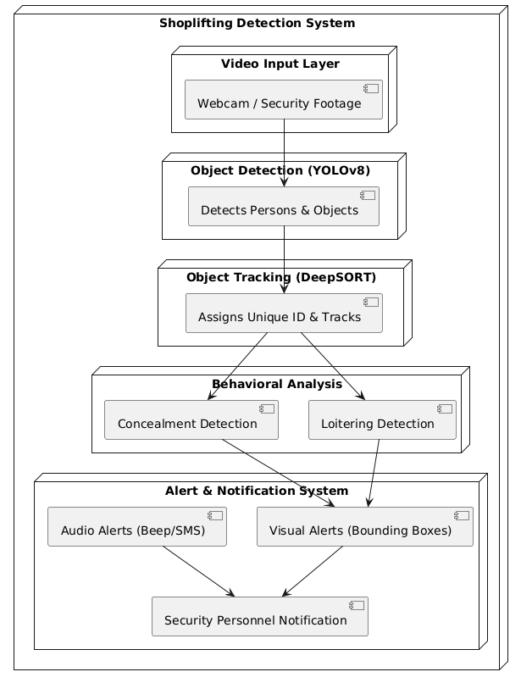
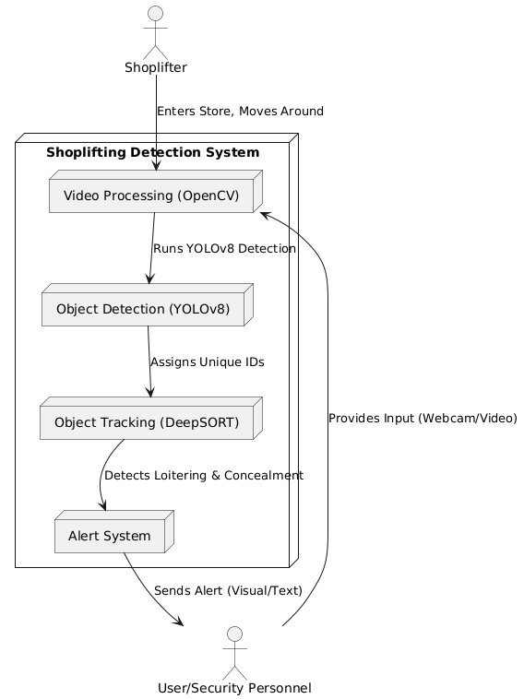
ARCHITECTURE DIAGRAM

Slide 8
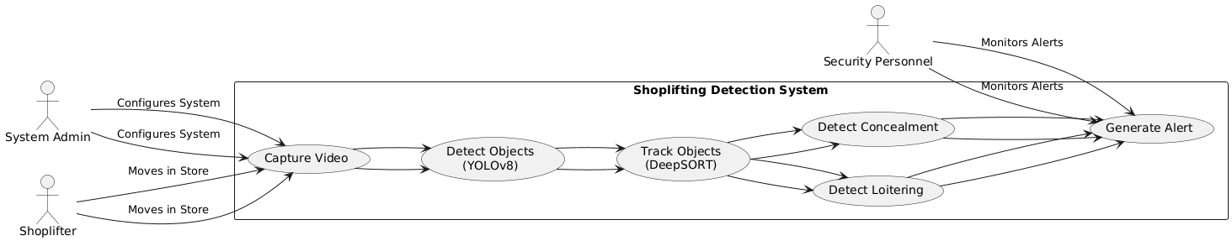
USE CASE DIAGRAM

Slide 9
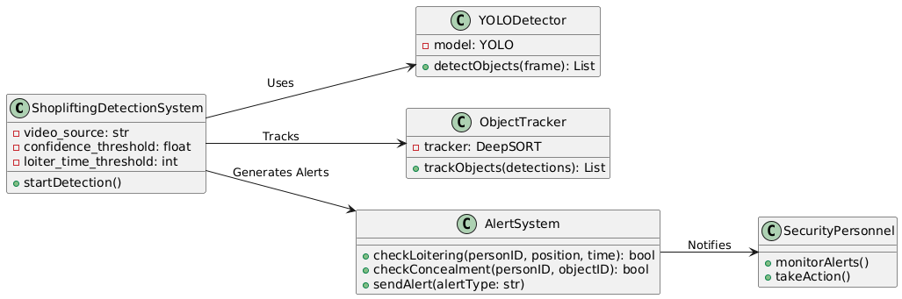
CLASS DIAGRAM

Slide 10
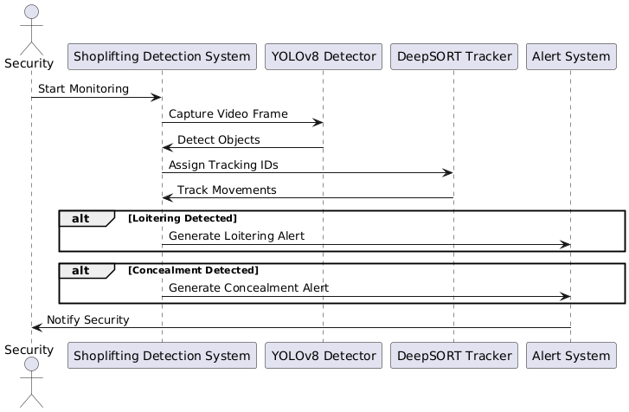
SEQUENCE DIAGRAM

Slide 11
CONCLUSION
The AI-based shoplifting detection system significantly improves retail security by automating theft detection through real-time object recognition and tracking. Compared to traditional CCTV monitoring, this system offers higher accuracy, real-time intervention, and reduced reliance on manual oversight.
By identifying loitering and concealment behaviors, it provides early warnings to security personnel, reducing financial losses from shoplifting. Future enhancements could include multi-camera integration, cloud-based monitoring, and predictive analytics for more robust retail security.

Slide 12
REFERENCE
https://universe.roboflow.com/stevens-institute-of-technology-xjltl/shoplifting-detection-oxvwp/model/1
https://www.kaggle.com/datasets/mateohervas/dcsass-dataset/code
https://www.mdpi.com/2076-3417/13/14/8341
https://ieeexplore.ieee.org/abstract/document/10707900

Slide 13
ANY QUERIES…?

Slide 14
Thank you

